Slide 1


Google Analytics
Data-Driven Insights for Digital Marketing Campaigns Summary
Presentation by:
Thambidurai Sundaramoorthy

Slide 2
Project Objective
To analyze the marketing data, create dashboards , and share actionable insights to optimize digital marketing.
To understand the key performance metrics, identifying trends, and making data-driven decisions to improve client ROI and enhance overall campaign performance.

Slide 3
Data Analysis
Data Cleaning and Pre-processing
Consolidated the raw data of Digital Marketing – Google Analytics Dataset.
Verified the data types of each column and updated it in the standard format.
The country name which was updated as (not set) in the dataset has been removed considering it as null.
KPI metrics CTR, CPC, ROI and Conversion Rate have been calculated for the available data using the formula updated in the solution approach document.
Power BI Dashboard were created using the consolidated dataset.

Slide 4
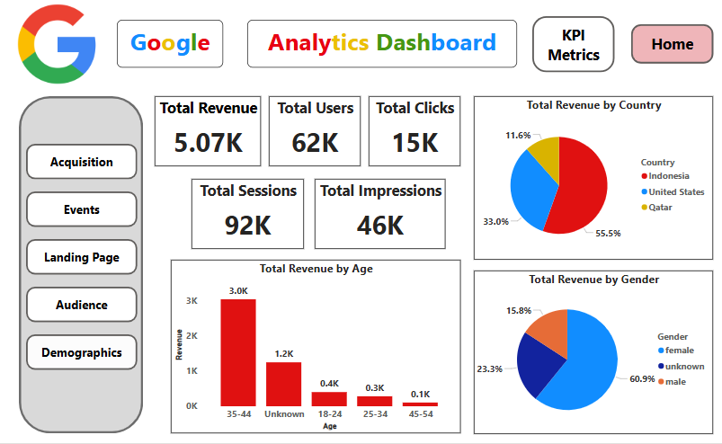
Home Page

Slide 5
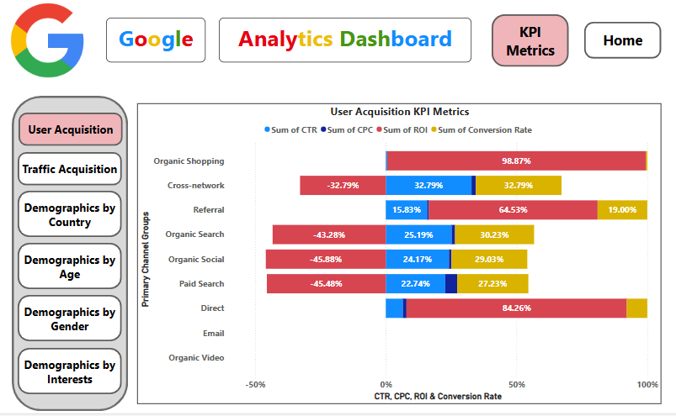
User Acquisition KPI Metrics

Slide 6
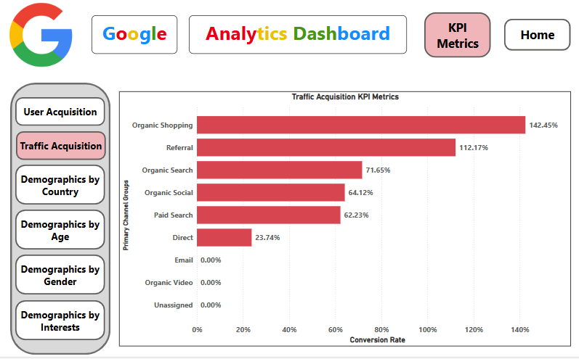
Traffic Acquisition KPI Metrics

Slide 7
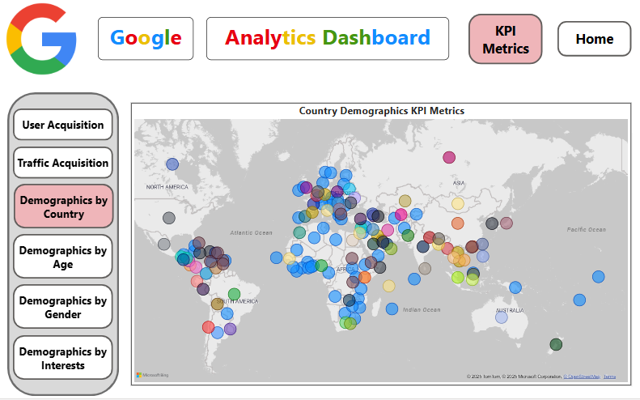
Country Demographics KPI Metrics

Slide 8
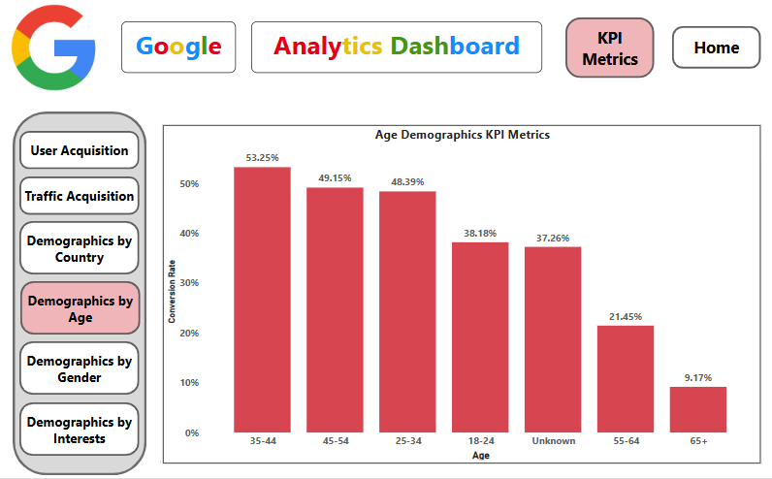
Age Demographics KPI Metrics

Slide 9
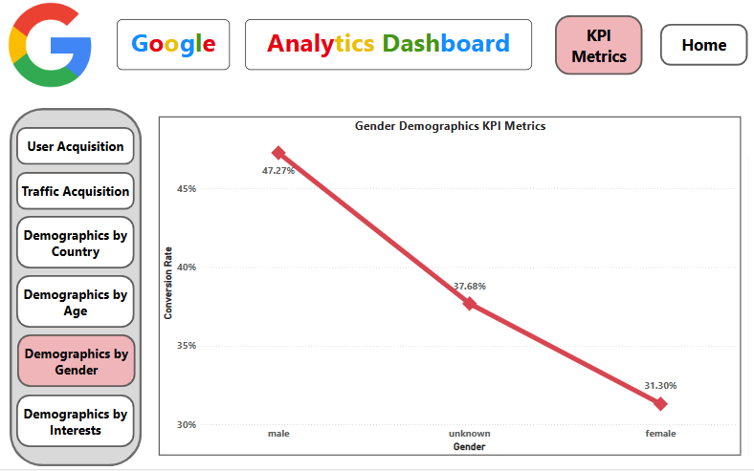
Gender Acquisition KPI Metrics

Slide 10
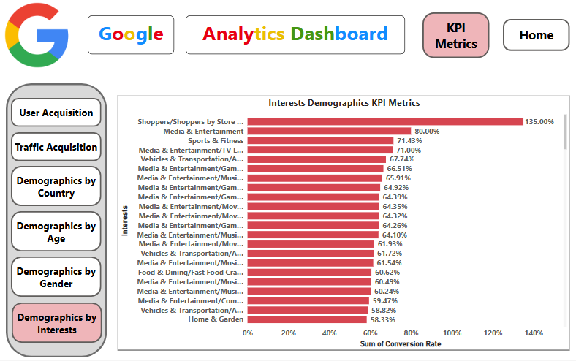
Interests Acquisition KPI Metrics

Slide 11
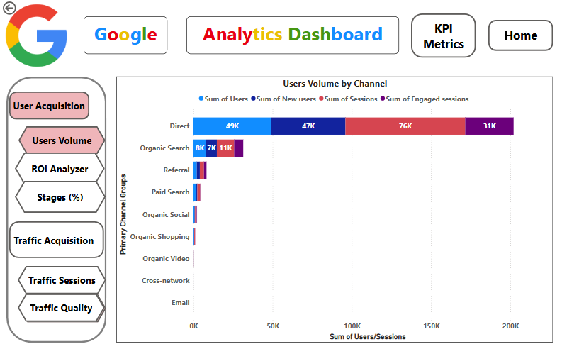
User Acquisition Users Volume

Slide 12
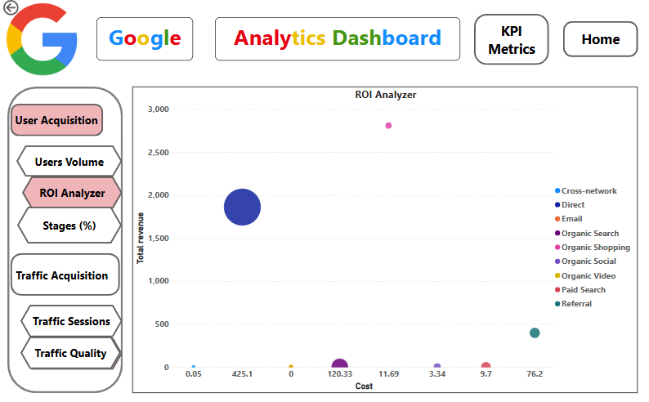
User Acquisition ROI Analyzer

Slide 13
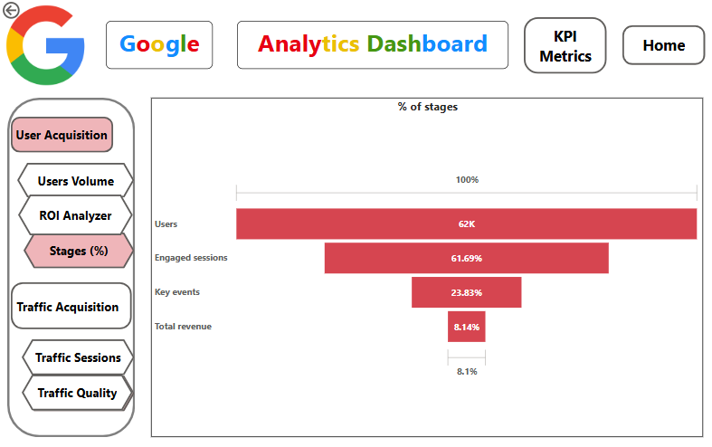
User Acquisition % Stages

Slide 14
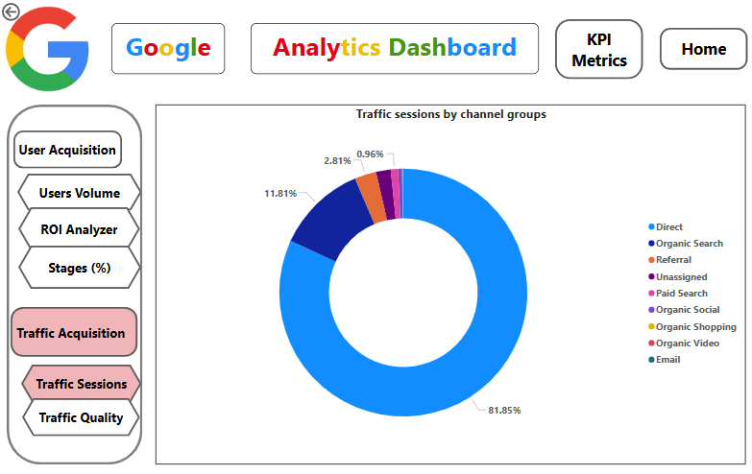
Traffic Acquisition Sessions

Slide 15
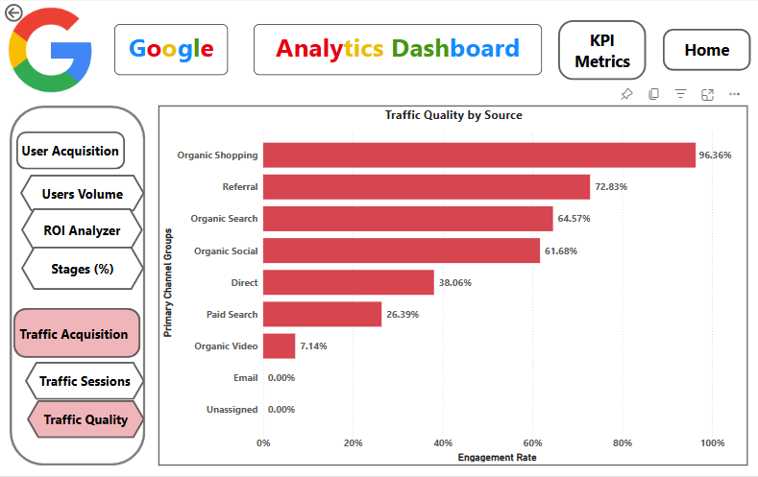
Traffic Acquisition Engagement Rate

Slide 16
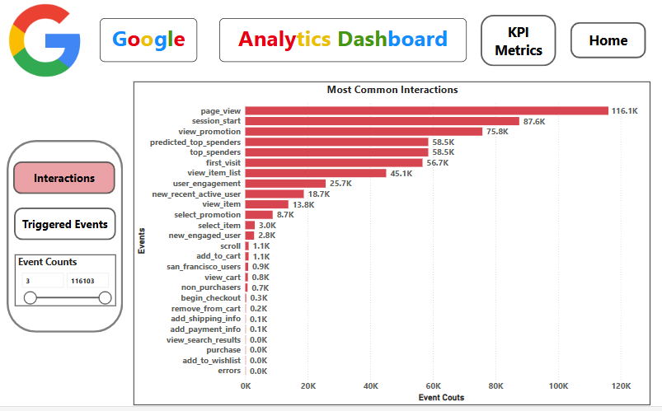
Interactions

Slide 17
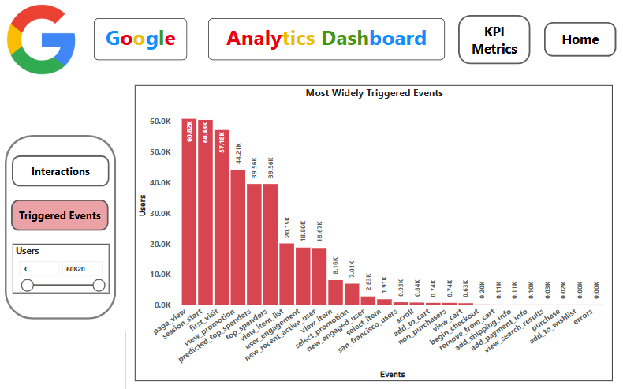
Triggered Events

Slide 18
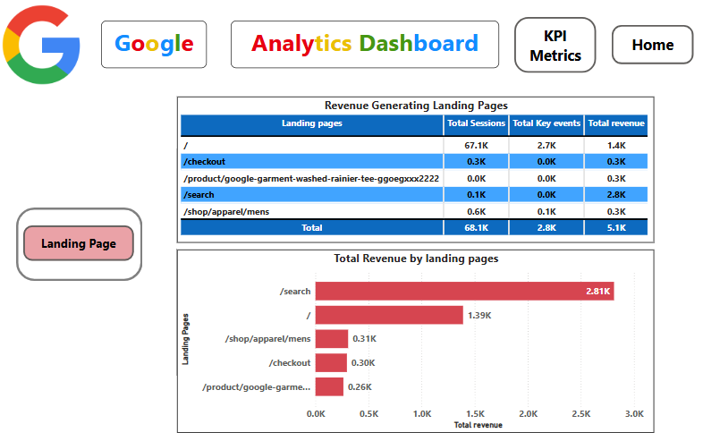
Landing Page

Slide 19
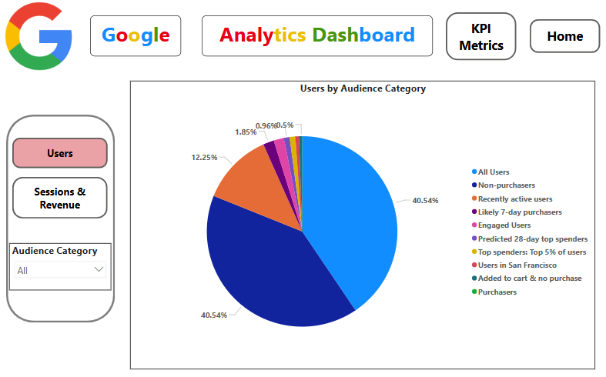
Audience Users

Slide 20
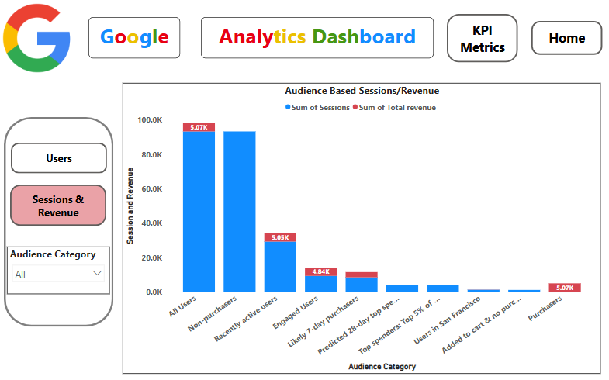
Audience Sessions & Revenues

Slide 21
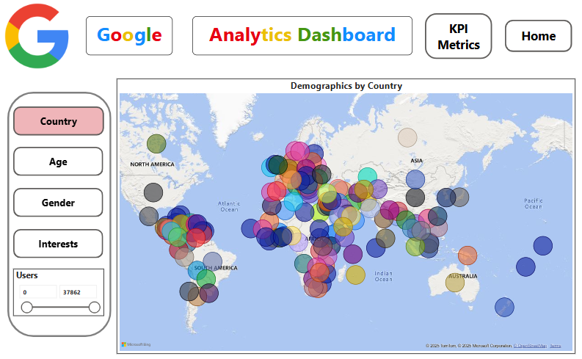
Country Demographics

Slide 22
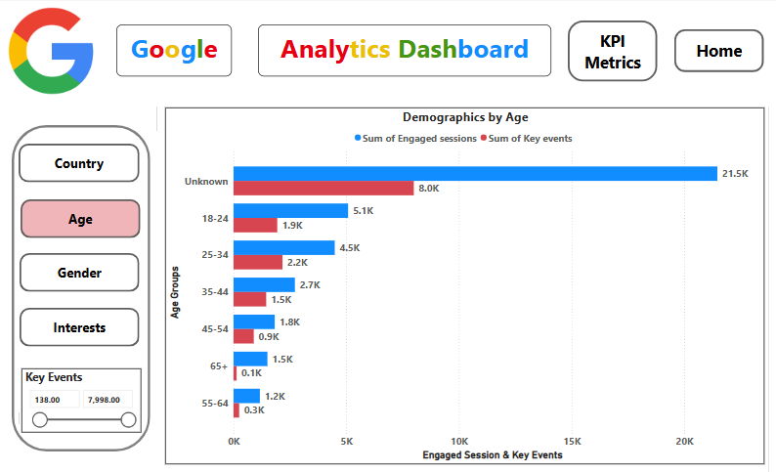
Age Demographics

Slide 23
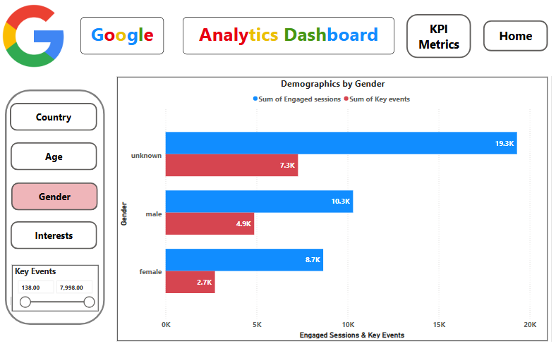
Gender Demographics

Slide 24
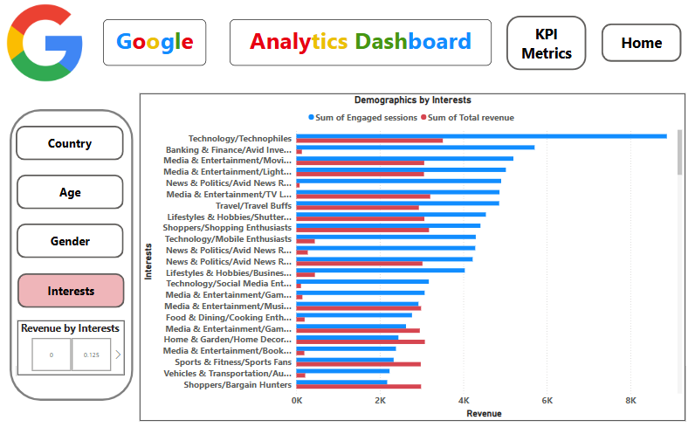
Interests Demographics

Slide 25
Strategic Plans
High-Performing Channels Referral & Organic Search Referral has the highest conversion rate and the highest ROI. Organic Search also shows high engagement and a decent CTR. Actions: Strengthen SEO with targeted content and backlinks. Identify top referring sites and invest in partnerships or guest content there. | Low-Performing Channels Paid Search & Direct Traffic Paid Search has High CPC, low engagement (sessions/user), zero revenue and negative ROI. Direct traffic, despite high volume, has low conversion and low engagement. Actions: Audit Paid Search keywords/ad copy and apply A/B testing. Segment Direct traffic to understand low conversion (e.g., branded users, internal traffic). Consider attribution modeling to see where these channels assist conversions.

Slide 26
Strategic Plans
Improve Engagement and Funnel Conversion Key Metrics: Bounce rate proxies (low engagement sessions). Engaged sessions per user and Average engagement time. Opportunities: Channels with low engagement per user need to improve the landing page experience. Actions: Optimize landing pages (UX/UI, value prop clarity). Personalize content based on the source/campaign. Use retargeting for quick exits with dynamic creatives. | Utilize Event Insights Top events: view_promotion, predicted_top_spenders, and top_spenders have high event counts but no attributed revenue. Actions: Investigate whether these events are linked to meaningful outcomes (or just predictive). Tie events to conversions with goal/event tagging in GA. Introduce micro-conversions (e.g., add to cart, time on page) to score intent.

Slide 27
Strategic Plans
Optimize for Cost Efficiency Low CPC, High Impact Channels: Organic Social has the lowest CPC and reasonable engagement. Actions: Increase content distribution on social platforms. Use UGC, influencer collaborations, or brand storytelling to boost reach. | Implement Time-Based Trend Analysis While the dataset doesn’t currently include time-series data, it's essential to include. Actions: Segment CTR, CPC, and Conversion Rate by week/month. Identify peak performance windows to adjust bidding and budget schedules.

Slide 28
Audience-Based Optimization Strategy
Audience group with revenue: Focus on “Engaged Users” for High ROI Campaigns as this audience is small (2.6k users) but highly engaged and drives significant revenue. Re-Engage “Recently Active Users” as they are with large user base , good engagement and revenue. Also, they're primed to convert again. Test Localized Campaigns for “Users in San Francisco” as they are small group, low engagement and modest revenue. “Purchasers” Segment: To Upsell & Retention as they are small but valuable group. Convert “Likely 7-Day Purchasers” Faster as they have high intent, mid-level engagement and revenue. Also, they're on the edge of conversion. | Actions: Retarget “Engaged Users” with personalized product recommendations. Send time-sensitive email campaigns with dynamic content and offer free shipping or first-time discounts for “Recently Active Users”. Run geo-targeted ad creatives with localized messaging for “Users in San Francisco”. Build “Purchasers” with post-purchase email flows: cross-sell, product care tips, referral incentives. Push “Likely 7-Day Purchasers” with urgency-driven ads like (ending soon, flash deals) and use personalized retargeting ads highlighting previously viewed products.

Slide 29
Audience-Based Optimization Strategy
Audience group with No revenue: Unlock Revenue from “Added to Cart & No Purchase” as they have high intent but no conversions. Investigate “Top Spenders & Predicted 28-day Spenders” as they have high value prediction, not realized. | Actions: Trigger automated abandoned cart emails with a limited-time incentive for “Added to Cart & No Purchase”. Verify if tracking or attribution is missing and send exclusive early access offers or VIP rewards for “Top Spenders & Predicted 28-day Spenders”.

Slide 30
Country Demographics
Remarks: Out of 158 countries in the list, 1 country name was not available due to which it has been removed. Only 3 countries United States, Indonesia and Qatar have generated revenues. Some countries like Canada, India and Taiwan have large user base with good engagement rate but no revenue. Countries like China and Japan have large user base with less engagement rate and no revenue. There are almost 122 countries with less than 100 users and engagement rates which is considered as low volume. | Actions: Double Down on High Performers by Optimizing campaigns in India, Australia, Malaysia, and the UK and use A/B test for landing pages to increase conversion rates further. Retarget Engaged But Non-Converting Users who shows high interest but low conversion. Use retargeting, personalized follow-ups, or local offers. Pause or Revamp Underperformers for countries with less engagement or conversions unless there's a strategic reason to keep them. Test Localized Content like tailoring copy, visuals, and offers in local language or cultural context.

Slide 31
Age Demographics
Remarks: Age group 35–44 is being considered as Top Segment with highest revenue and conversion rate. Age groups 25–34 and 45–54 are with high Intent, low Revenue. They have strong engagement and conversion rate but revenue isn't proportionate. Age group 18-24 has an emerging opportunity with high traffic and decent conversion. Age groups 55–64 & 65+ have low Engagement and Zero Revenue with short session duration, no conversions. Unknown Age has large audience volume and decent conversions. | Actions: Prioritize this age group 35–44 in paid media spend and create exclusive offers. Improve product recommendations to increase AOV and add value-driven messaging for the age groups 25-34 & 45-54. Use social-first and influencer-driven campaigns and offer student pricing and discounts for the age group 18-24. Evaluate whether this age group 55–64 & 65+ audience is relevant to product offerings. Encourage profile completion or account login to capture age for the Unknown Age group.

Slide 32
Gender Demographics
Remarks: Females generate the most revenue despite the lowest conversion rate—high-value audience. Males are the most efficient converters, with highest engagement and conversion rate. "Unknown" gender accounts for 60%+ of users, but low revenue per user and short engagement time. | Actions: Improve conversions while maintaining revenue for Females through Personalized messaging: Showcase product benefits/value propositions that resonate more with female audiences. Scale efficiently and increase ROI for Males by using performance-driven creatives: Focus on stats, benefits, bold CTAs. Identify, clean, and retarget the Unknown Gender by Improve gender detection: Encourage profile completion (gender field) during signup and use inferred gender detection via tools (based on names or behavior).

Slide 33
Interests Demographics
Remarks: Home & Garden, Shoppers, Lifestyle & Hobbies, Media & Entertainment and Travel categories are rated as high-value segment with high user base and high revenue generating categories. Technology, Sports & Fitness, News & Politics categories is moderate in terms of revenue generating, user base and engagement. Banking & Finance, Beauty & Wellness, Food & Dining and Vehicles & Transportation has low user base and revenue due to which it is segmented as underperforming segment. Shoppers with 7% user base still managed to achieve the revenue of 21% from the total revenue which is 2nd overall. | Actions: Double down on ad spend for high-value segment and prioritize 60-70% of the budget. Maintain budget and improve landing page performance with custom messaging per interest group for moderate segment. Run test campaigns with varied creatives and focus on awareness or lead generation rather than conversion. If ROI remains poor after 2–3 optimizations, deprioritize or pause these underperforming segments.

Slide 34

Thank You
Thambidurai Sundaramoorthy
stdurai95@gmail.com

